Slide 1
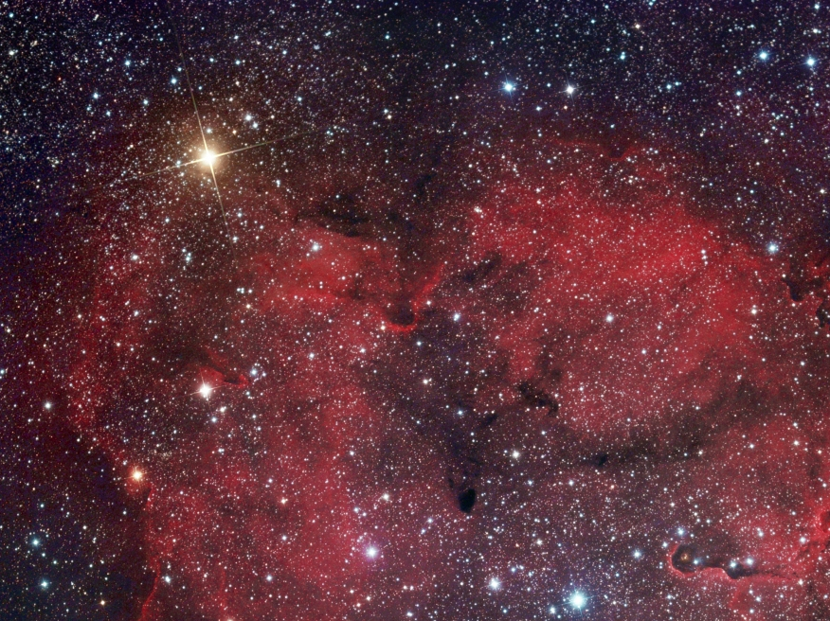
Mu Cephi
Other Names:
The Garnet Star
Herschel’s Garnet Star
Erakis

Slide 2
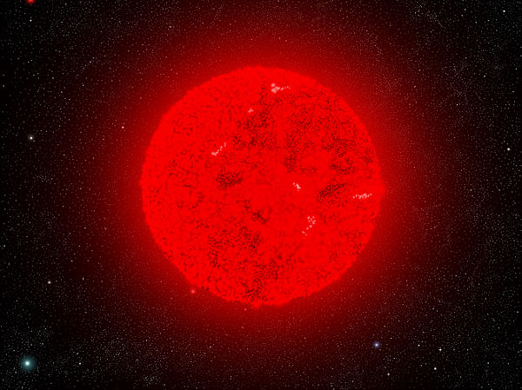
Mu Cephei
“the Garnet Star”
It is likely the largest star visible to the naked eye, and one of the largest known. If it were in place of the Sun, it would stretch to somewhere between Jupiter and Saturn. It could fit about 2 billion Suns into its volume.

Slide 3
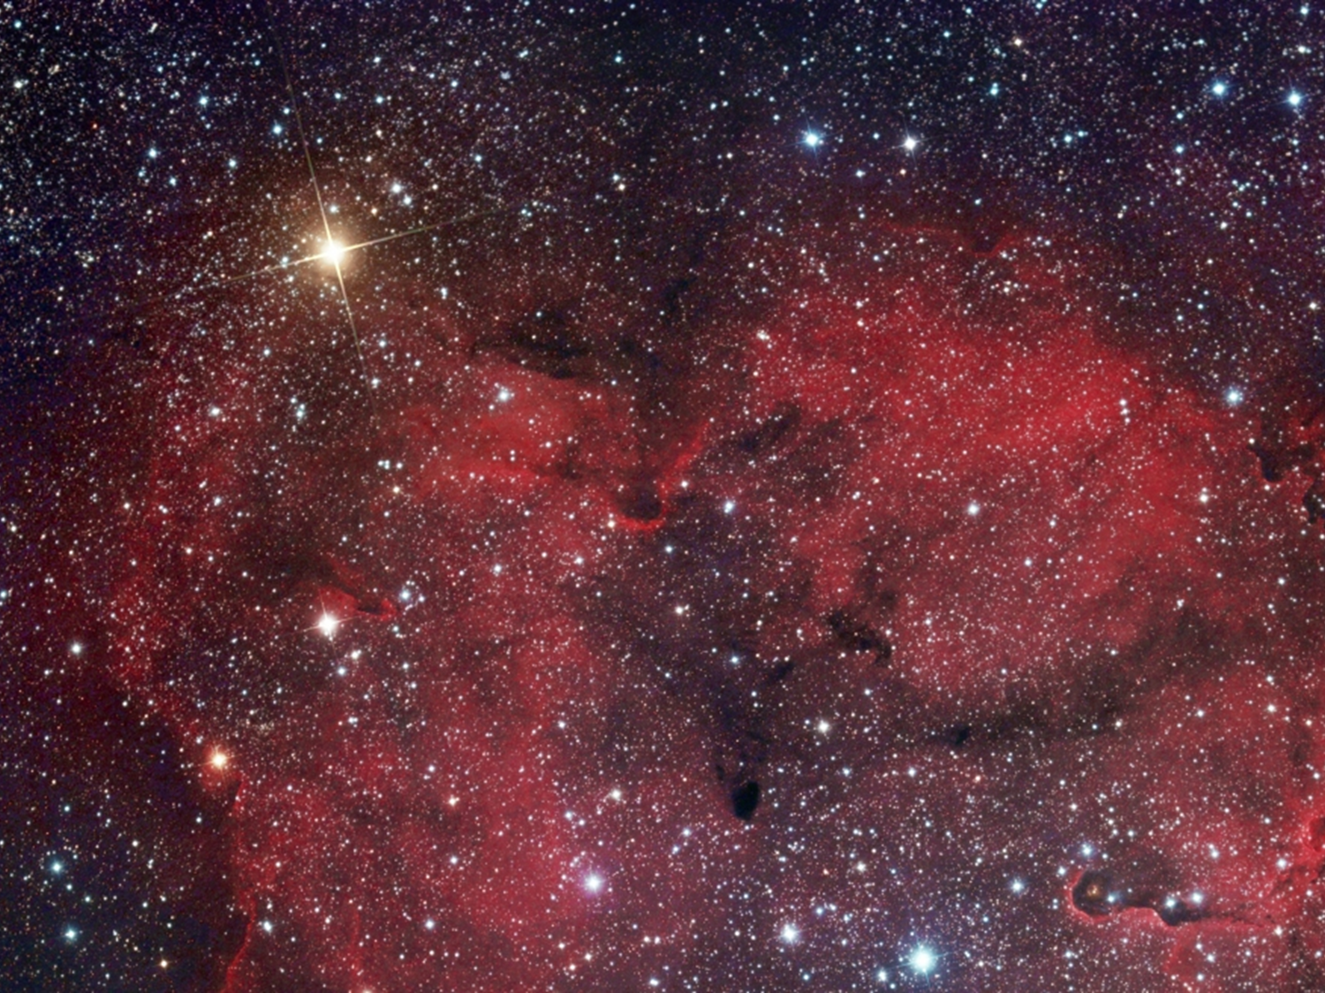
Mu Cephei
“the Garnet Star”
This is a red variable carbon-star supergiant in the constellation Cepheus.

Slide 4
This is a dying star and has already begun to fuse helium into carbon. Eventually its core will be converted to iron and it will collapse to produce a supernova. After the explosion, the gaseous remnant will likely be massive enough to form a black hole.
Mu Cephei
“the Garnet Star”

Slide 5
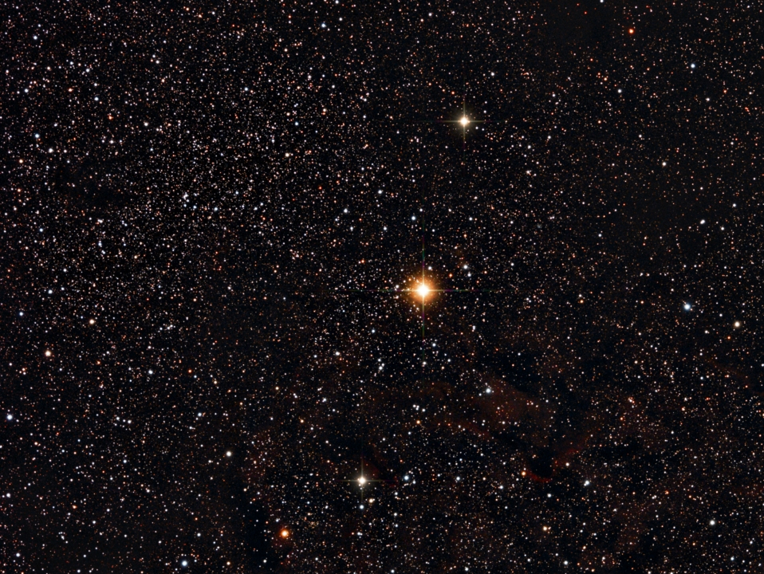
It has semi-regular variability, with periods reported near to either 860 days or 4,400 days. It is actually a double star.
Mu Cephei
“the Garnet Star”

Slide 6
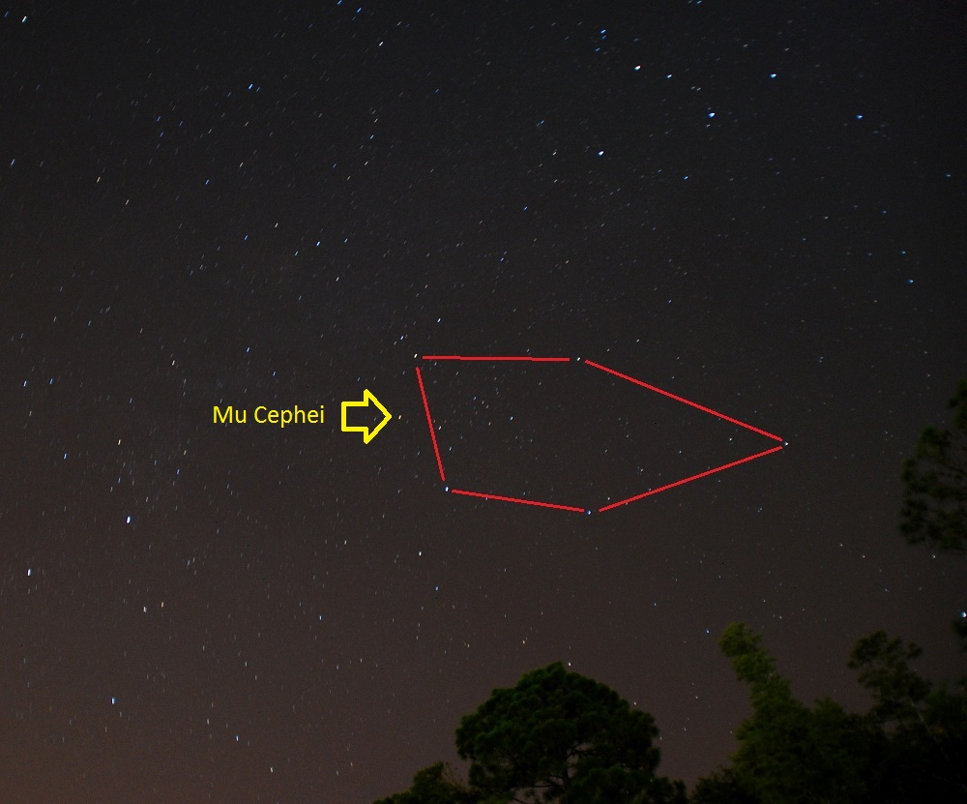

Slide 7
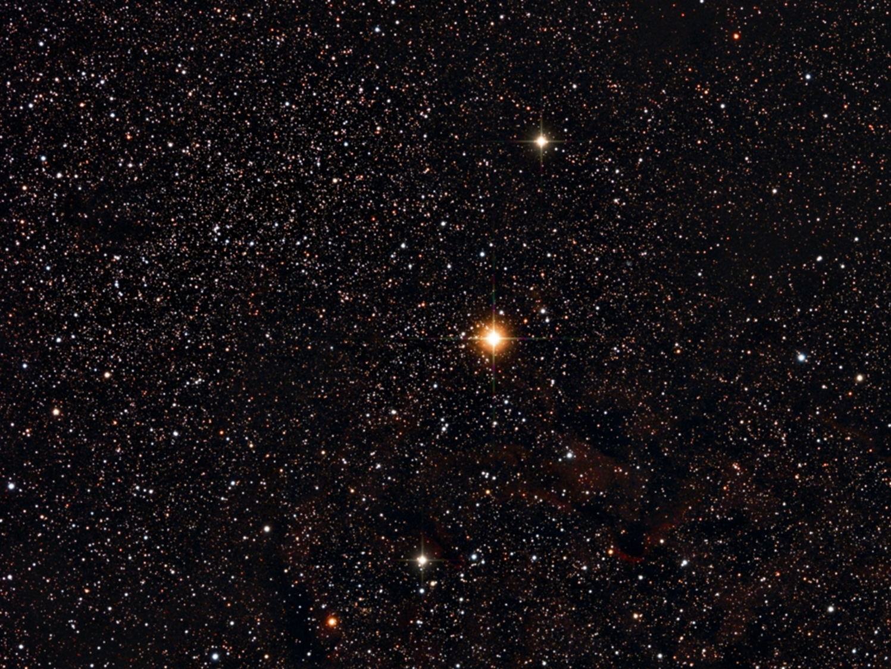
Size: radius is estimated between 1,450 times and 1,650 times that of the Sun
B-V Color Index: +2.24, red
Luminosity: 11,700 Suns visual or 100,000 times as bright as the Sun…or maybe even as much as 600,000 times brighter than the Sun
Mu Cephei

Slide 8
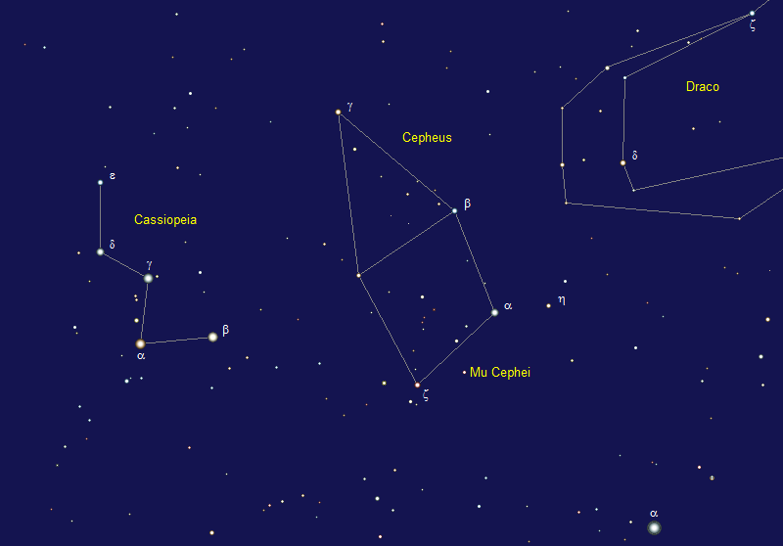
Constellation:
Cepheus
Mu Cephei

Slide 9
Distance: Estimating is hard…somewhere between 2,400 to 6,000 light years away
Temperature: 5610⁰ F
Mu Cephei

Slide 10
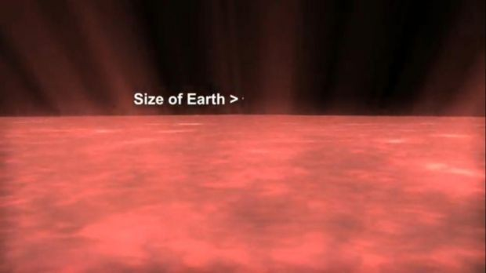
Mu Cephei

Slide 11
Mass: 19 times our Sun
Magnitude Range: +3.43 to +5.10
Mu Cephei

Slide 12
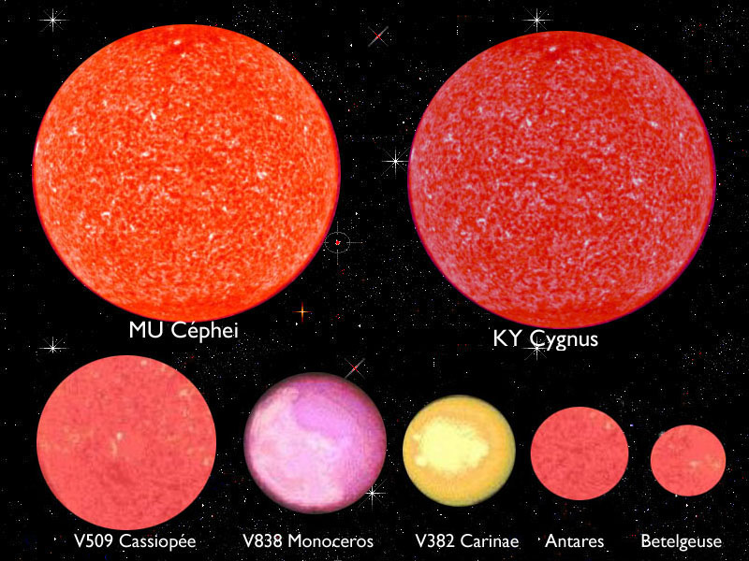
The
Sun

Slide 13
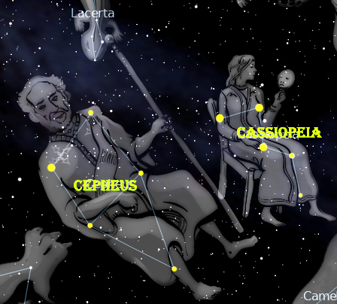
Mu Cephei

Slide 14

Carbon Star Basics
As sun-like stars age, their core compresses and heats up and basically cooks the helium nuclei into carbon. The convective currents in the star’s atmosphere move the carbon from the core to the outer layers where they form a fine soot. The soot scatters away blue and green light, so only the red and orange wavelengths penetrate the carbon dust to reach our eyes.

Slide 15
Carbon Star Basics
• Sunsets are red for similar reasons to carbon stars. At the horizon, sunlight travels through more atmosphere, scattering away the blues and greens, leaving the red for our eyes.
• All carbon stars are variable and vary in brightness over the course of months or even more than a year.

Slide 16


Slide 17


Carbon Star Basics

Slide 18

Carbon Star Basics
Carbon stars vary in color. What color do you see in the telescope?

